Slide 1
Cross-Platform Migration Using LLMs
Generative AI Case Study
Done by Vijayadharshni

Slide 2
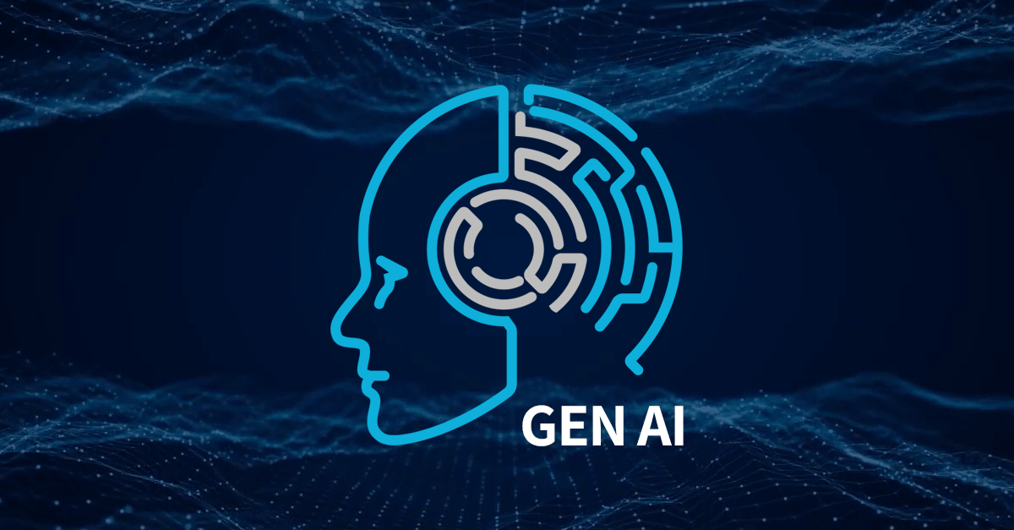
What is Generative AI?
Generative AI creates new content—text, images, code—by learning patterns from vast data.
Examples: ChatGPT, DALL·E, and AI code assistants.
It’s transforming industries by automating creative and complex tasks.

Slide 3
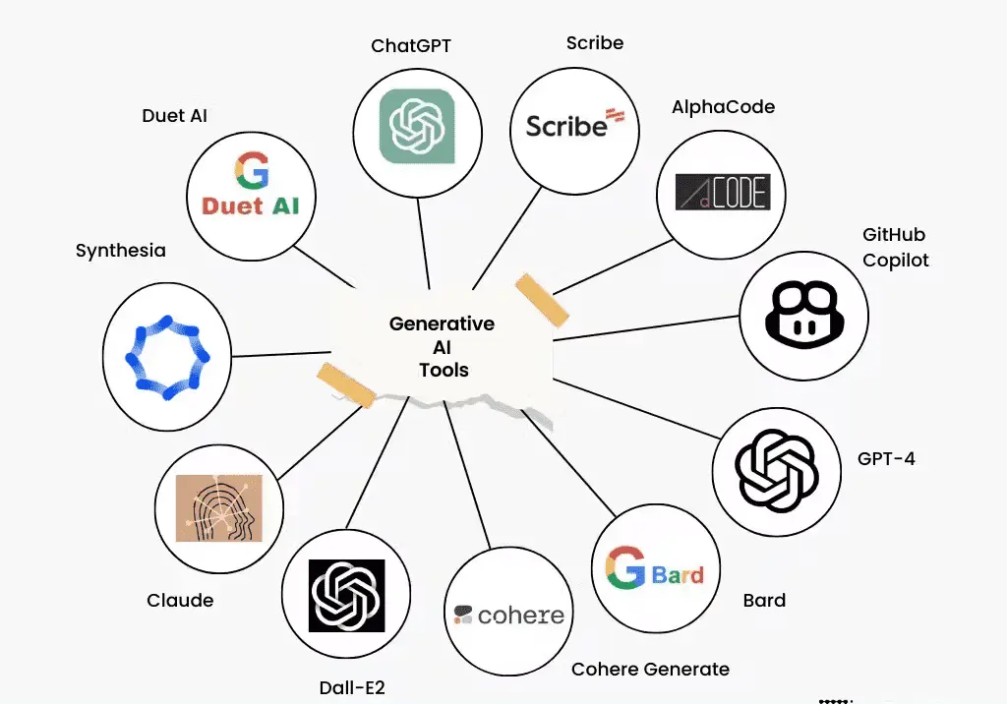
What is a Large Language Model (LLM) ?
LLMs are AI models trained on massive text datasets to understand and generate human-like language.
They process input prompts by predicting the most likely next words, enabling coherent responses.
Behind the scenes: tokenization, context windows, and deep neural networks.
Examples: OpenAI’s GPT series, Meta’s LLaMA, and others powering chatbots and code generation.

Slide 4
Learnings from Exploring Generative AI
Understanding AI’s limitations and human oversight remains essential.
Basics of GenAI, LLMs, embeddings, vector stores, and prompting.
Understanding prompt engineering, RAG.
Tools such as LangChain for automation.

Slide 5
Case Study Overview: Migrating a .NET Core Application to Spring Boot Java Using LLMs
The case study focuses on using Large Language Models (LLMs) to migrate an existing .NET Core Web API project to a Java Spring Boot project. The goal is to automate cross-platform code conversion using AI by translating controllers, services, repositories, models, and configurations from C# (.NET) into equivalent Java (Spring Boot) code with minimal manual effort.

Slide 6
Project Flow: From .NET Core to Spring Boot Using LLM
1. Input Folder Received
.NET Core project (~20 files)
Contains: Controllers, Services, Repositories, Models, DTOs
2. File Classification
Identify each file using:
  Naming conventions (e.g., *Controller.cs)
  Folder structure
  Class attributes/inheritance

Slide 7
3. LLM-Based Conversion
Controller Prompt → Spring Boot @RestController
Service Prompt → Spring @Service
Repository Prompt → JPA Repository
Model Prompt → JPA @Entity
Files processed one-by-one due to LLM token limits
4. LLM Output
Generates equivalent Java code:
  @RestController
  @Service
  @Repository
  @Entity with JPA annotations
5. Saving Converted Files
Organize output into Spring Boot folder structure:
/controller
/service
/repository
/entity
/dto

Slide 8
Conclusion
This case study demonstrates how LLMs can automate cross-platform code migration from .NET Core to Java Spring Boot efficiently. By converting each component (controllers, services, repositories, models) through file-specific prompts, LLMs reduce manual rewriting effort.The workflow ensures structured, accurate, and consistent Spring Boot code generation. Although human review is still needed, LLM assistance significantly speeds up migration and improves productivity. This project highlights the practical use of Generative AI in real-world software modernization.

Slide 9
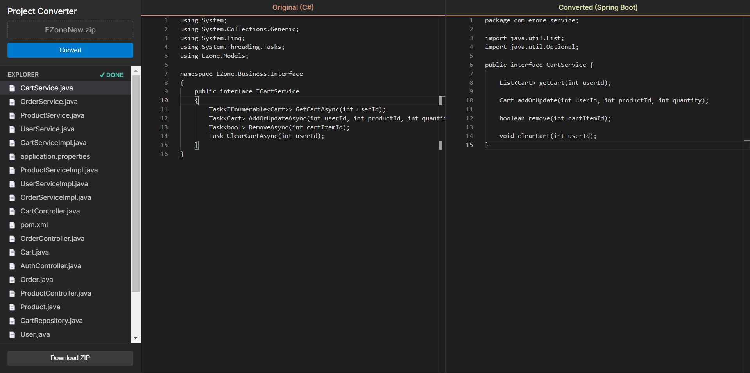
Output 2

Slide 10
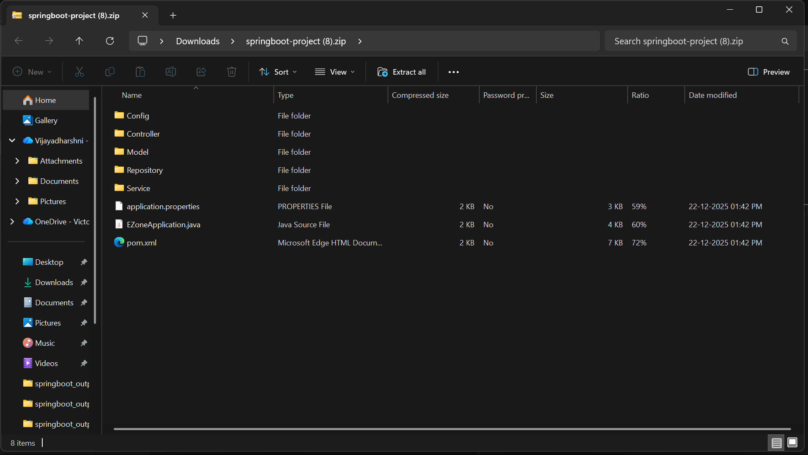

Slide 11
